Slide 1
Eclipse Plugin Development

Slide 2

What
is a
Plugin?

Slide 3

Where
is it
Used?

Slide 4




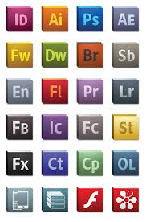





Slide 5


Slide 6





Slide 7

ECLIPSE

